Slide 1


A Shot that Changed the World - The Assassination of Franz Ferdinand
1. Who was Franz Ferdinand?
a. A famous artist
b. A politician
c. A military leader
d. An Austrian archduke
2. In what year was Franz Ferdinand born?
a. 1860
b. 1863
c. 1870
d. 1880
3. What significant event happened to Franz Ferdinand's cousin in 1889?
a. He became emperor
b. He renounced his title
c. He died by suicide
d. He married a noblewoman
4. Who was Franz Ferdinand’s wife?
a. Duchess Sophia
b. Maria Theresa
c. Queen Elizabeth
d. Princess Anne
5. What was one of Franz Ferdinand's notable hobbies?
a. Painting
b. Hunting
c. Gardening
d. Writing
6. How did Franz Ferdinand feel about the Hungarians?
a. He respected them
b. He hated them
c. He was indifferent
d. He admired their culture
7. Who assassinated Franz Ferdinand
a. A Serbian soldier
b. A Bosnian politician
c. Gavrilo Princip
d. An Austrian officer
8. What did Franz Ferdinand think of the Slavs?
a. He viewed them as equals
b. He had no opinion
c. He admired their resilience
d. He thought they were less than humans
9. What did the Black Hand provide to Princip and his associates?
a. Money
b. Safe passage
c. Pistols and bombs
d. Fake identities
10. How did Franz Ferdinand and Sophia arrive in Sarajevo?
a. They traveled by train
b. They drove a car
c. They rode horses
d. They walked

Slide 2
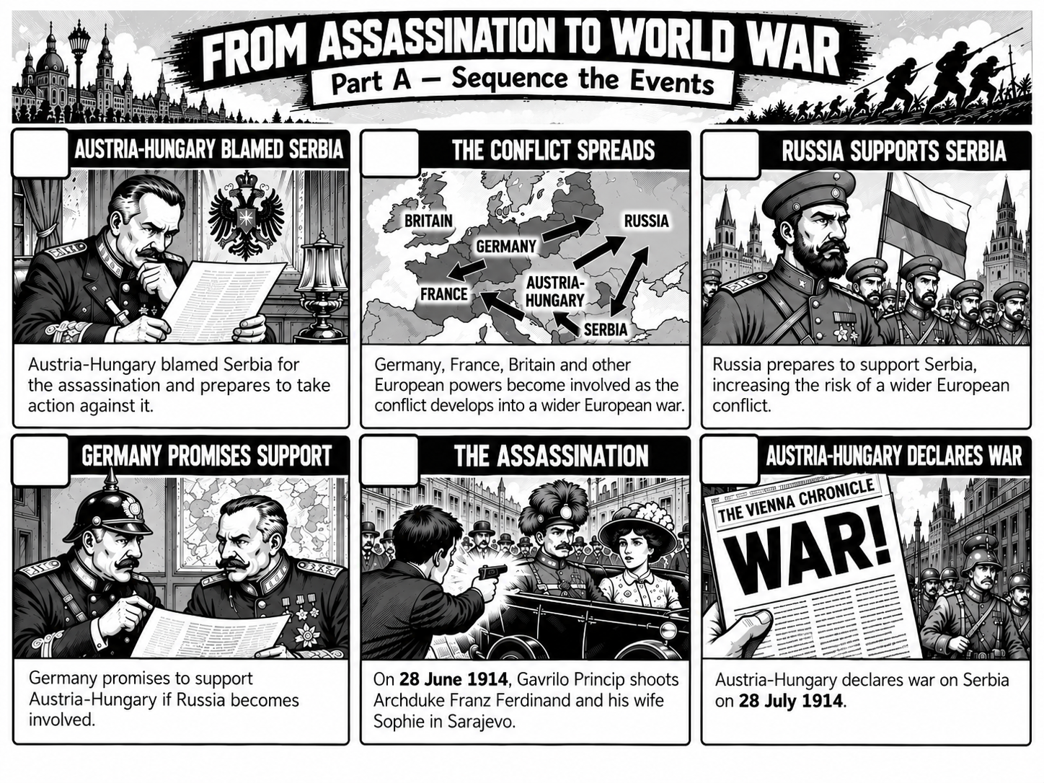

Slide 3
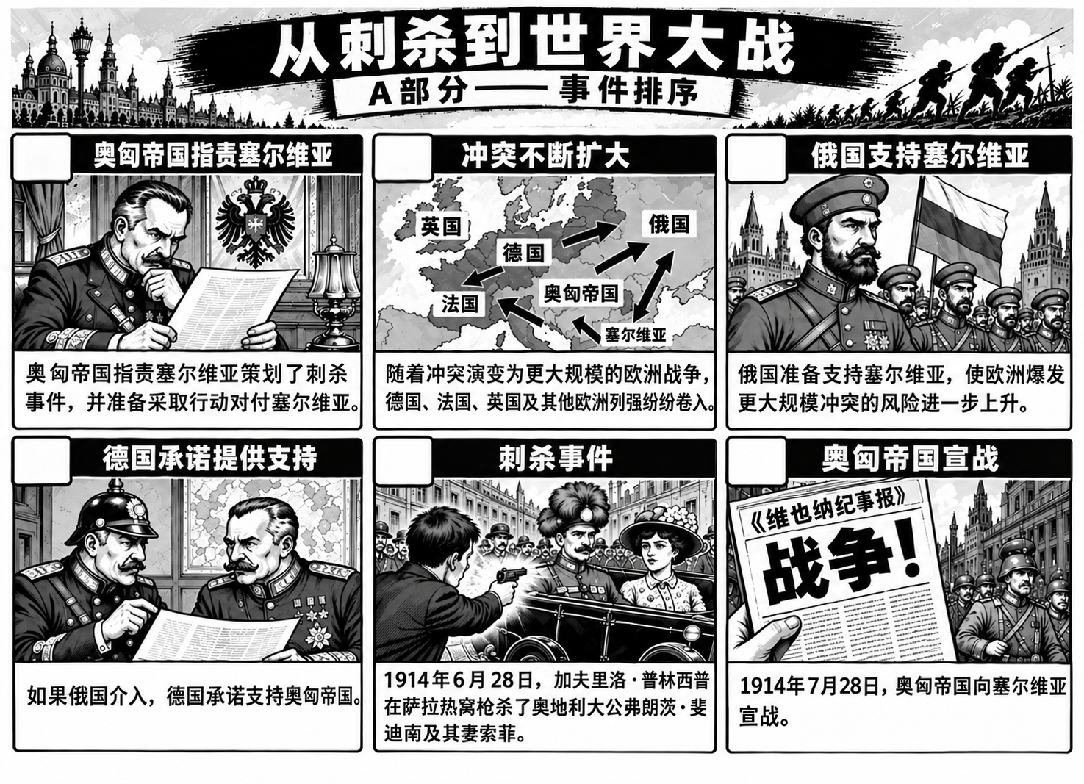

Slide 4
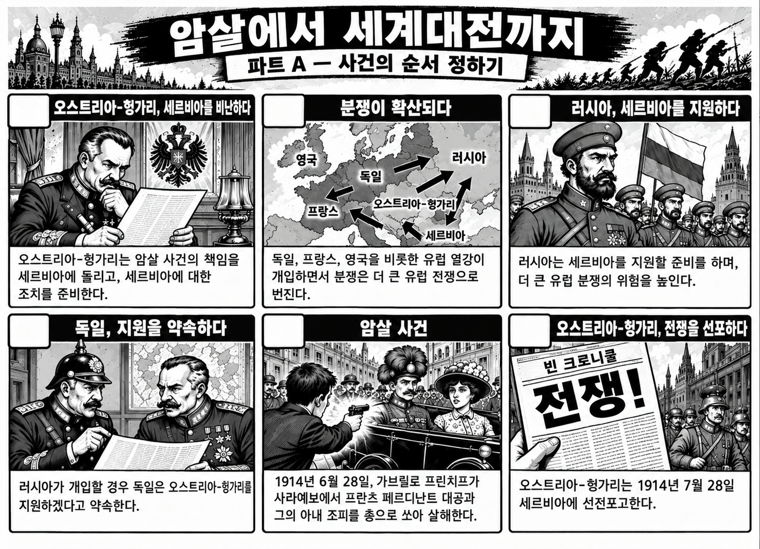

Slide 5
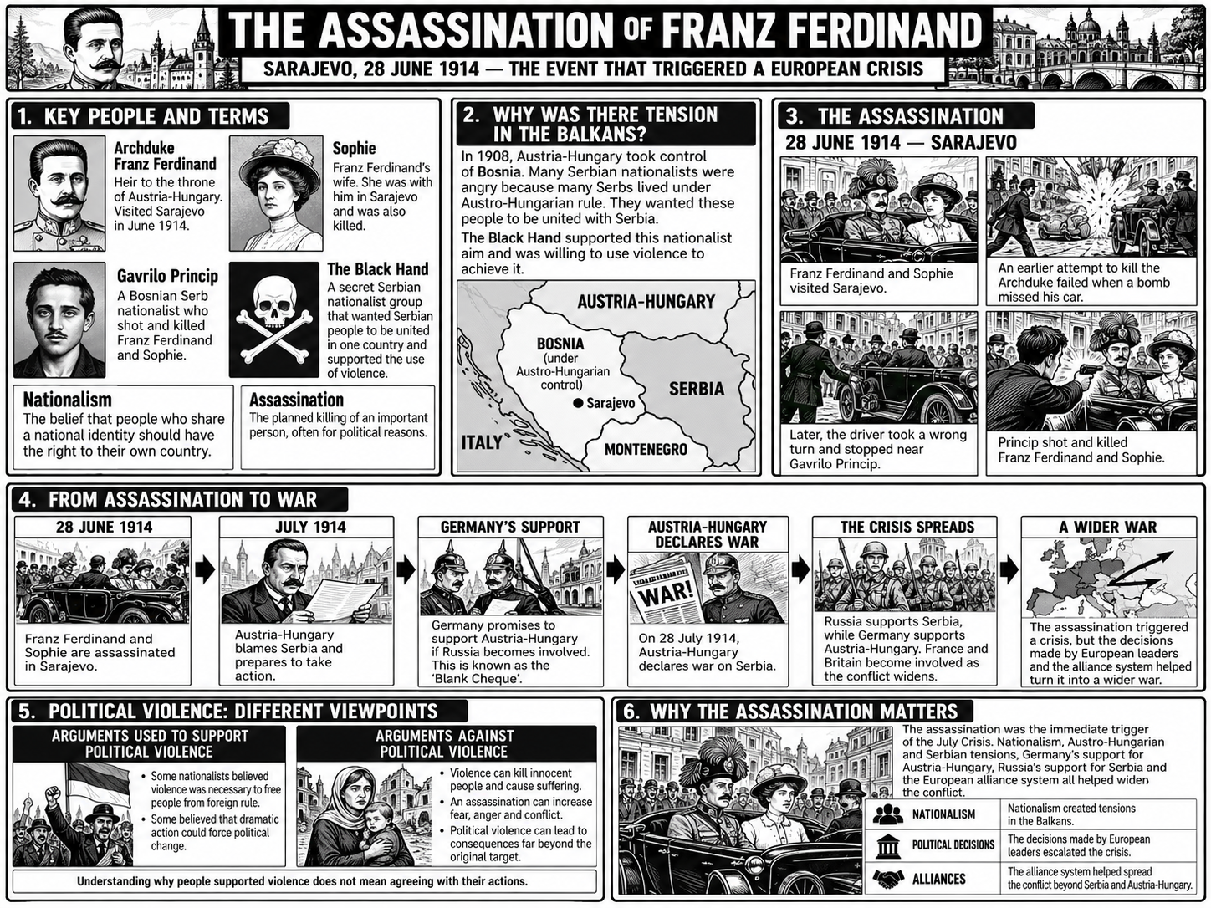

Slide 6
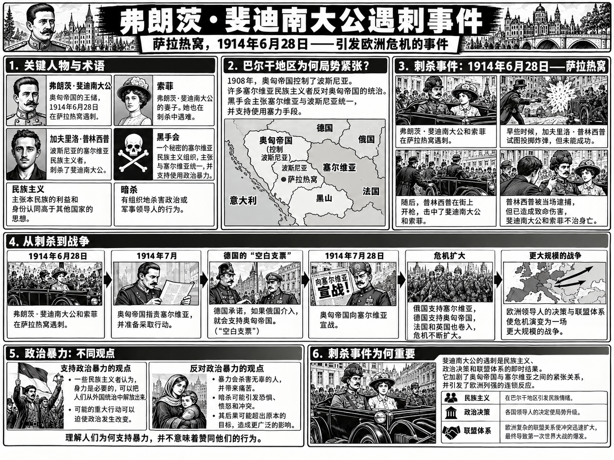

Slide 7
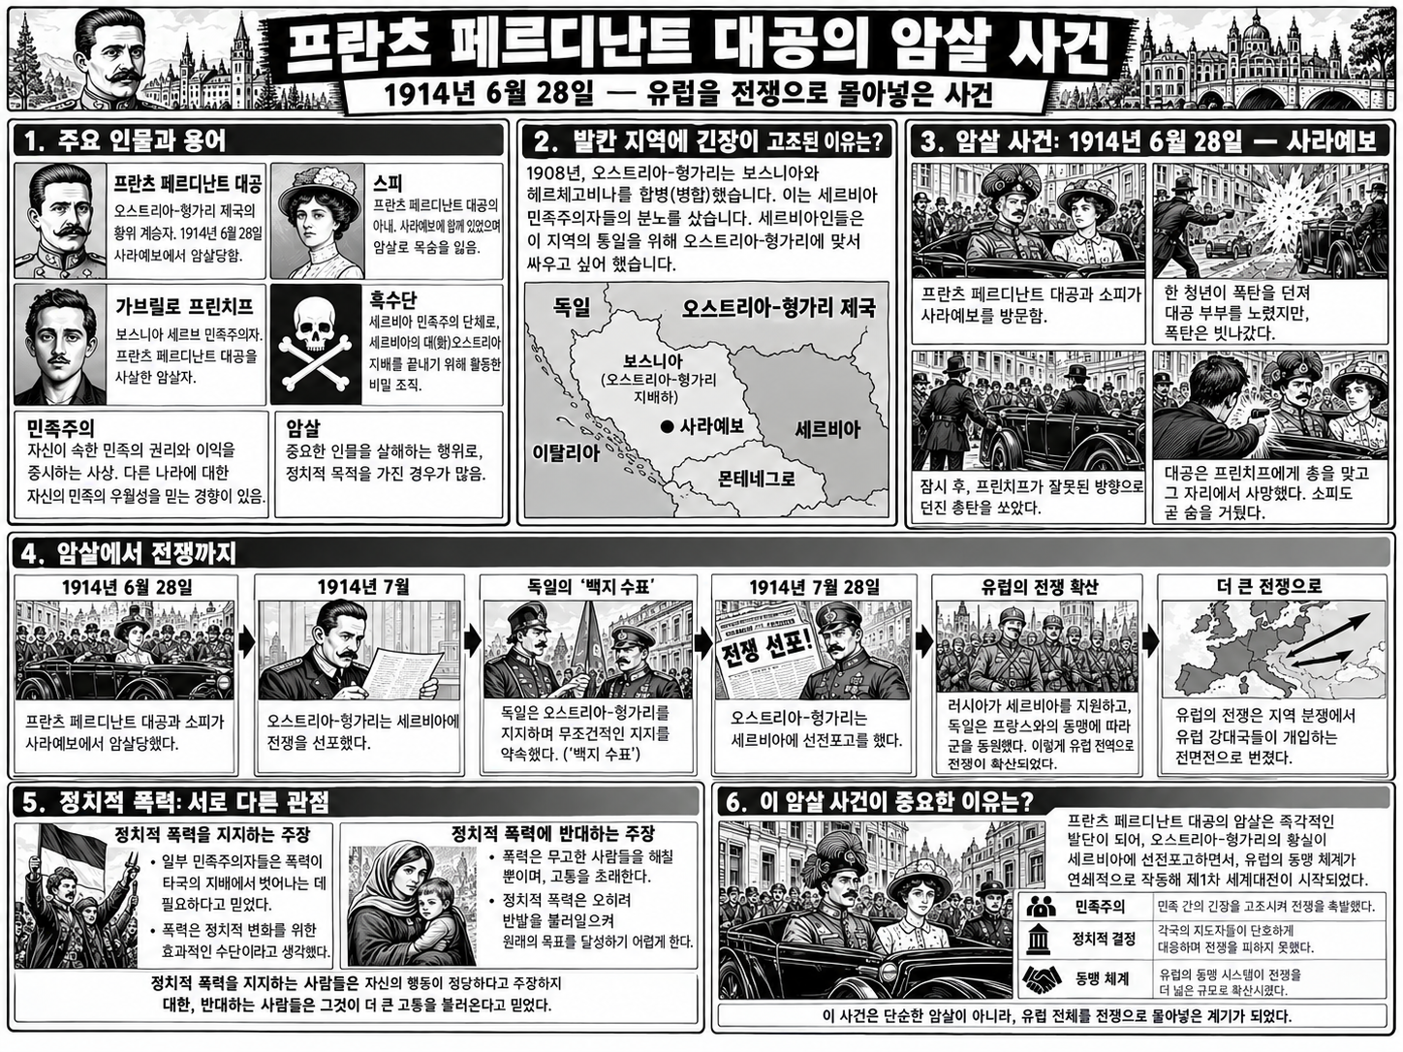

Slide 8
